Slide 1
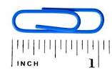
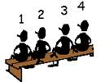
Non Metric Units of Measurement
mile
yard
oz
pounds
lbs
pint
inch
ft
Nemetriniai matavimo vienetai
feet

Slide 2
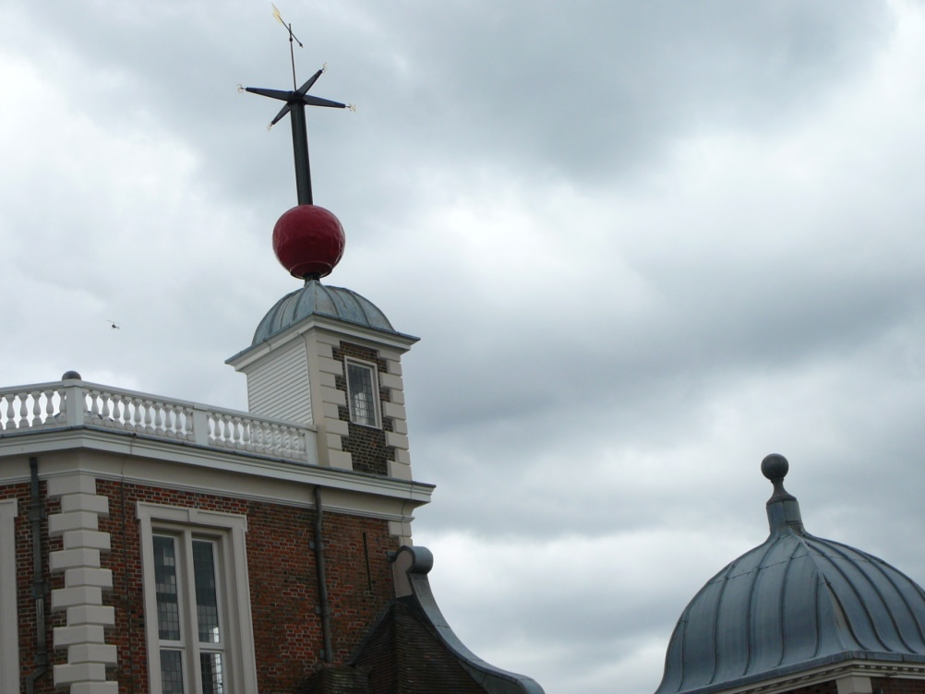
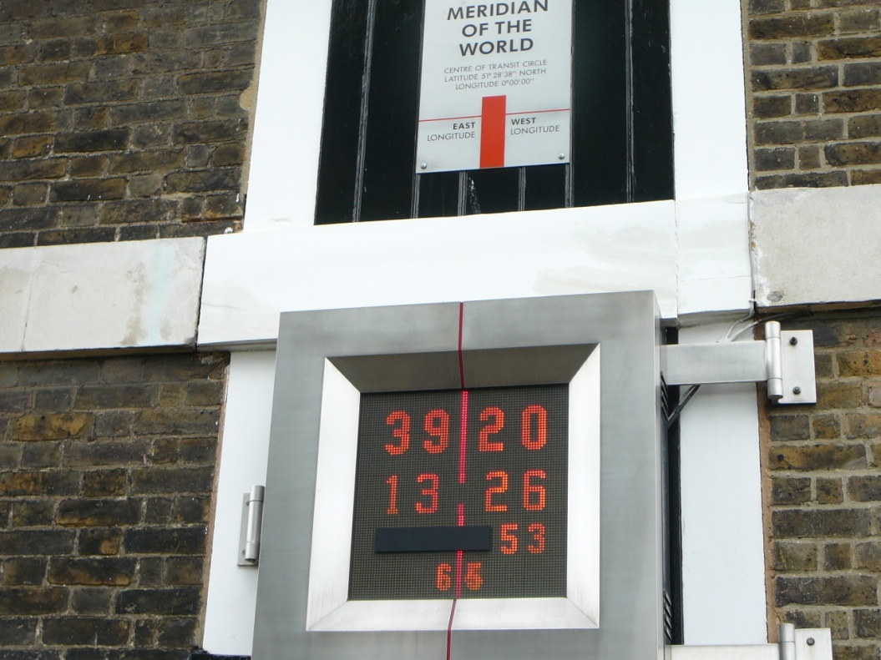
Greenwich, London

Slide 4
Map of countries officially not using the metric system
Liberia
The USS
Myanmar
The 2006 CIA Factbook stated that the "US is the only industrialized nation that does not mainly use the metric system", (in addition to non-industrialised Burma /or officially the Republic of Myanmar and Liberia.
However, the actual situation is more complex.
http://www.zmescience.com/other/map-of-countries-officially-not-using-the-metric-system/

Slide 5
Although the UK has accepted a metric system in 1995, but they still use imperical units (The British Imperial) defined in the British Weights and Measures Act of 1824
Milk is sold in multiples of 1 pint sized containers
Jam is sold in 454g - 1lb jars
Road distances are all signed in miles
Most people still measure their height in feet and inches and their weight in stones, pounds, and ounces
Also the Imperial pint is a permitted unit for milk in returnable bottles and for draught beer and cider in British pubs

Slide 6
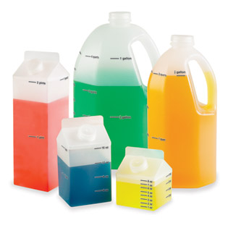
The U.S. non metric system
They use a system called the U.S. customary system (also called standard or English units or older British/English units/systems).
Here are some measurements (small to large).
Distance: inches, feet, yards, miles.
Fluid Volume: teaspoon, tablespoon, fluid ounce, cups, pints, quarts, gallon.
Weight: ounce, pound, ton.

Slide 7
A speedometer used in American and British cars, showing the speed of the vehicle in miles per hour (outer, in white) and kilometres per hour (inner, in red)
METRICATION
Metrication is the conversion to the metric system of weights and measures, began in France in the 1790s and spread widely during the following two centuries.
http://en.wikipedia.org/wiki/Metrication

Slide 8
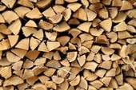
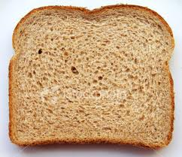
Collocations – words used together
Measuring quantities:
A hectare of lands
A pile of woods
A piece/slice of bread
A pint of milk

Slide 9
Idioms & sayings with non metric units
- To be a million miles away – to be lost in thought;
daydreaming and not paying attention
- Trying to fit two gallons in a one gallon jug
E.g. “They want us to have classes of 35 children in rooms that can only take 20. Typically they want to get a quart into a pint pot.“
Give somebody an inch and they'll take a mile –
means that if you allow someone to behave badly at all,
they will start to behave very badly

Slide 10
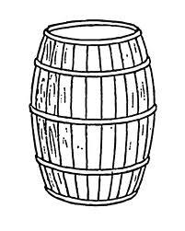
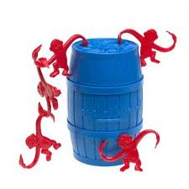
A barrel of water ...
A barrel - barelis (skysčių/biralų tūrio vienetas)
A riddle:
A barrel of water weighs 20 pounds what must you add to it to make it weigh 12 pounds? (holes☺)
A barrel of monkeys – a hyperbole - it means a good-natured chaotic state, - 1 monkey is amusing, 2 or more double it, but a barrel of monkeys...
We can say “Funny like a barrel of monkeys”
or
“My uncle is like a barrel of monkeys" – he’s really amusing.
A barrel of laughs – linksmas, visada juokaujantis žmogus/ linksmas žaidimas

Slide 11
Valstybės žinių laikraščio rinkų ir finansų puslapiuose minimi nemetriniai mato vienetai:
1 barelis (bar.) = 158,987 l 1 JAV bušelis (buš.) = 35,2391 dm3 1 svaras (sv.) = 0,4536 kg 1 Tr. uncija (Tr.unc.) = 31,1035 g Plačiau: http://archyvas.vz.lt/news.php?strid=1002&id=396817#ixzz2bNlQiDl1

Slide 12
Where could we find this ad (in which country)?

