Slide 1
WHAT IS A COMPUTER?

Slide 2
ARE YOU A “TECHIE” OR A TECHNOPHOBE?
A) A person who doesn’t like machines, especially computers
B) A computer system which allows millions of computer users around the world to exchange information
C) A system that is able to send different types of communication signals down a telephone line at the same time
D) A piece of software you install on your computer to protect it from viruses
E) A small object which you move with your hands to give instructions to the computer
F) The imaginary place where electronic messages, information, pictures exist when they are sent from one computer to another
G) Someone whose life is dominated by technology – especially computers
(ANTIVIRUS, BROADBAND, CYBERSPACE, INTERNET, MOUSE, TECHIE,
TECHNOPHOBE)

Slide 3
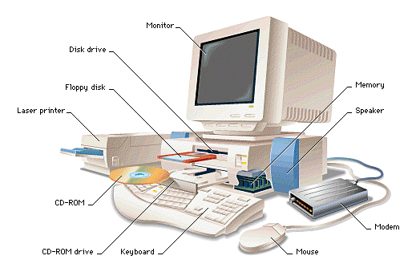

Slide 4
VOCABULARY
Monitor - vaizduoklis
Disk drive – diskų įtaisas
Floppy disk – diskelis / USB - atmintukas
Laser printer – lazerinis spausdintuvas
CD ROM – kompaktinis diskas
CD ROM drive – kompaktinių diskų leistuvas
Keyboard - klaviatūra
Mouse – pėlė
Modem - modemas
Speaker - garsiakalbis
Memory - atmintis
(http://ims.mii.lt/ims/%C5%BEodynai/en-lt/)

Slide 5
DISCUSS
Think about the activities you perform or want to perform using a computer (email, online shopping, etc.).
Think about all the computers that are necessary for you to complete your day-to-day activities.
Is it a computer that controls the stoplights so you can drive to work?
How did the cashier scan and calculate your grocery items?
Does the coffee store you visit use a computer to order their inventory?
Is the weather map on television computer-generated?

