Slide 1
TECHNIQUE ELEMENTS
FOOTBALL
Aims:
to drill warm-up exercises
to review the history of football
to learn terms and words related to football
to learn how to dribble the ball
to learn a few freestyle dribbling tricks with the ball

Slide 2


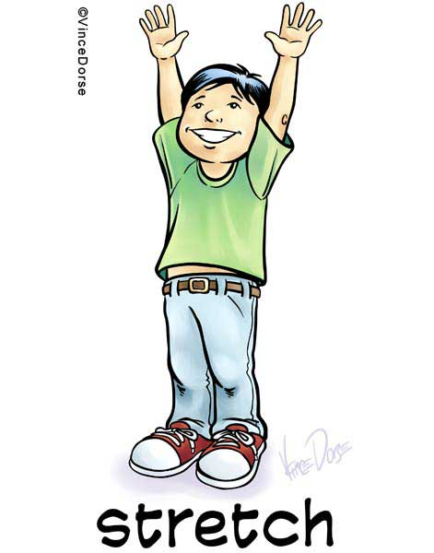
What is the Lithuanian for…?
down
up

Slide 3
What is the Lithuanian for…?

Slide 4
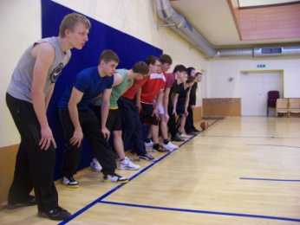
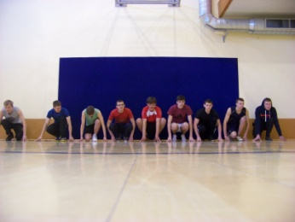
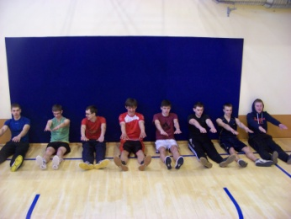
Warm-up exercises:
1. Line up, please. On the signal sprint ten metres and run back. The last one has to do 3 press-ups.
2. Squat down, please. Feet and hands on the line. Jump up and sprint to the centre-line. The last one has to do 6 press-ups.
3. Sit down, please. Legs and arms are stretched. Jump up and sprint to the centre-line. The last one has to do 9 press-ups.

Slide 5
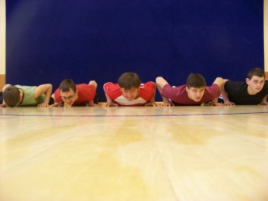
Warm-up exercises:
4. Lie down, please. The arms are stretched. Jump up and sprint to the centre-line. The last one has to do 12 press-ups.
5. Line up, please. Sprint 5 meters to the line, touch the line, come back, touch the line, sprint 10 meters to the next line. Do 10 press-ups and run back.

Slide 6
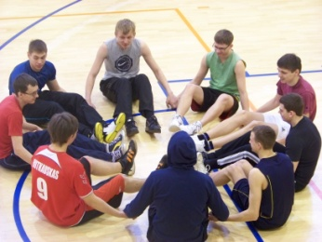
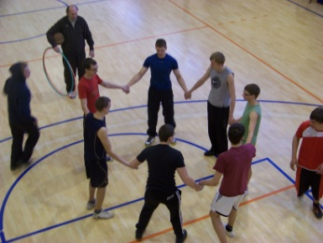
Warm-up exercises:
The students have to sit down in a circle, hold each others’ hands, bend the legs and do 10 sit-ups.
The students stand in a circle and hold each others’ hands. Two students are left out of the circle. One of them is a runaway, another one is a catcher. All students can move in different directions. The students standing in the circle should move in such a way that they protect the runaway.

Slide 7
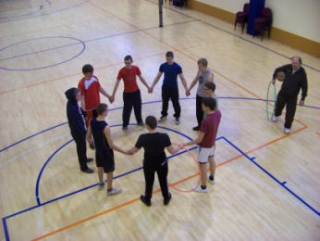
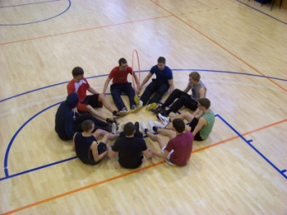
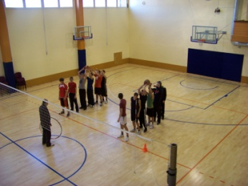
Warm-up exercises:
3. The students stand in a circle holding hands. Two students are given a hoop. The hoop has to go around the circle and return to the starting position.
4. The students sit down in a circle holding hands. Two students are given a hoop. The hoop has to go around the circle and return to the starting position.
5. The students line up one behind the other. The first student gives the ball to the student standing behind him and runs to the end of the line. The winner is the team that reaches the line first.

Slide 8
WHAT DO YOU KNOW ABOUT THE HISTORY OF FOOTBALL?
http://www.hornetfootball.org/documents/football-history.htm

Slide 9
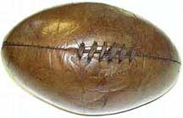
HISTORY OF FOOTBALL
It is believed that football (as well as rugby) originated from the ancient Greek game called harpaston.
Harpaston is mentioned frequently in classical literature where it is often referred to as a “very rough and brutal game“.
The rules of this ancient sport were quite simple:
  points were awarded when a player would cross a goal line by either kicking the ball, running with it across the goal line, or throwing it across the line to another player;
  the other team’s objective was simply to stop them by any means possible;
  there was no specific field length, no side line boundaries, no specified number of players per team -- only a total lack of rules.
Modern football originated in England in the twelfth century. The game became so popular in England that the kings Henry II and Henry IV actually banned football. They believed that football was taking away interest from the traditional sports of England such as fencing and archery.
http://www.hornetfootball.org/documents/football-history.htm

Slide 10
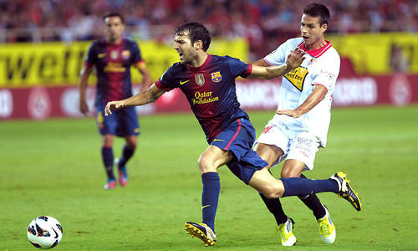
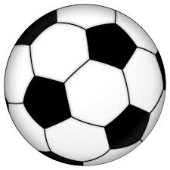
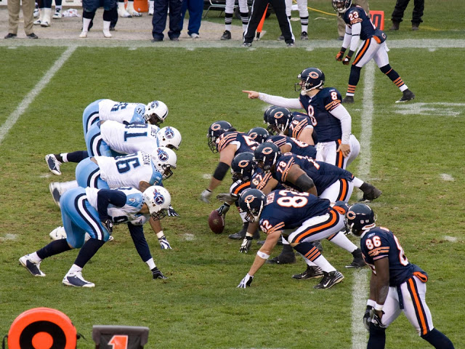
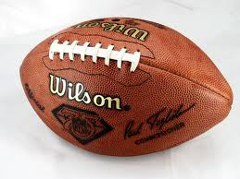
Football and soccer: is it the same game?
The name changes depending on the country.
In the majority of Europe and the world the name FOOTBALL is used for…
But in a few western countries like the USA and Australia the same game is called SOCCER, while the name football is used for a totally different game.
This is how American football is played.

Slide 11

What football club is presented below?
The club is based in Old Trafford, Greater Manchester. It plays in the Premier League. It was founded in 1878. Its nickname is the Red Devils. It won 20 League titles, a record 13 FA Cups, 4 League Cups. It also won 3 UEFA Club Winner’s Cup and one FIFA Club World Cup. Sir Alex Ferguson won 25 major honors, and 38 in total, from November 1986 to May 2013 when he announced his retirement. It is one of the wealthiest and most widely supported football teams in the world. The best known players include: Wayne Rooney, Robin van Persie, Ryan Giggs, Javier Hernandez, Shinji Kagawa, etc.
Do you know other football clubs?

Slide 12
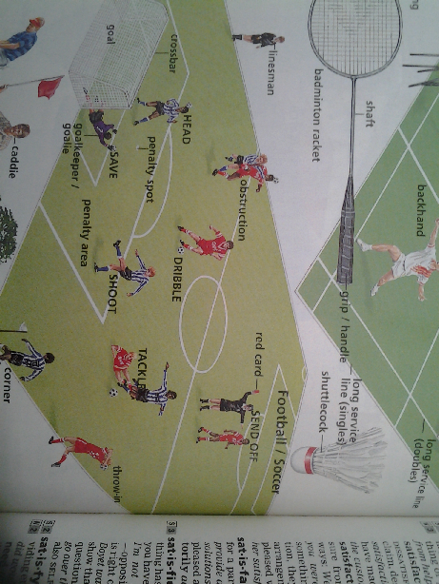
What is the Lithuanian for…?

Slide 13
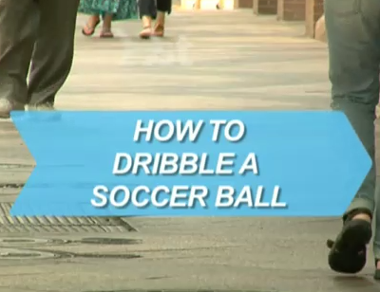
How to dribble the ball?
Place the ball on the grass in front of you.
Square the inside of your foot to the direction you want to move and tap the ball lightly in that direction.
Follow the ball closely.
Continue tapping and following the ball down the field.
Try using the other foot too.
Practice by running faster
still controlling the ball.
7. Try dribbling around the
obstacles such as cones.
8. Find an opponent for
your practice.

Slide 14
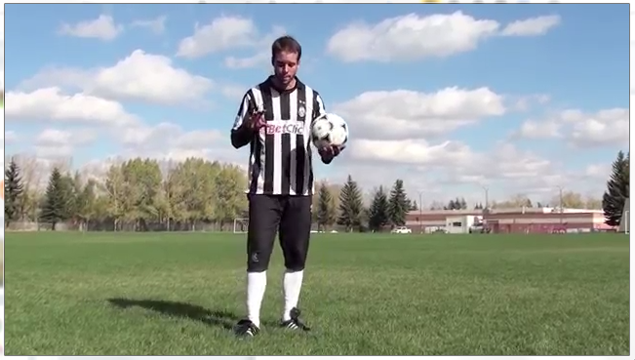
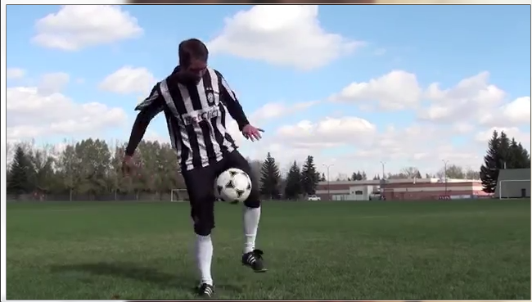
Freestyle tricks with the football:
Foot stall – flex your foot, put the ball on it, throw the ball.
Knee stall – squeeze the ball between your knees, throw the ball.
Back stall – pinch your shoulder blades together and make ‘a pocket’ on your back, use it to catch the ball.
Head stall – where ever the ball goes, stay in the centre of it to bounce it on your head.
Heel pop – trap the ball between the foot and the ankle, roll it up and pop it up.

Slide 15
Next class we will go outside to try what we have learnt!

