Slide 1
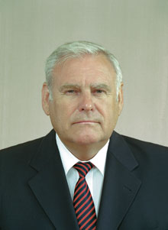
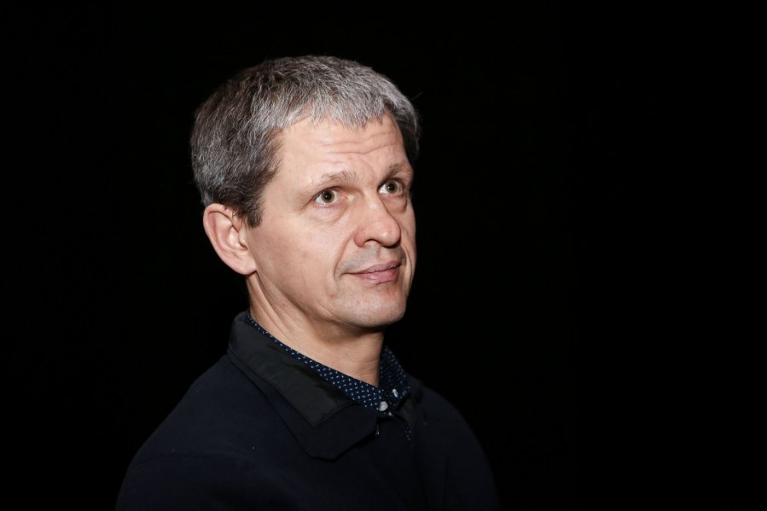
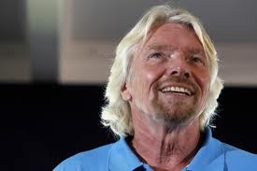
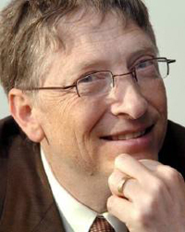
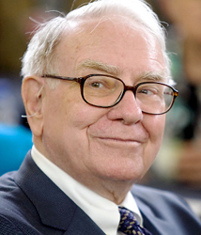
WHO ARE THEY?

Slide 2
Nerijus Numavičius
Bronislovas Lubys
Bill Gates
Warren Buffet
Richard Branson

Slide 3
Features of a businessman:
- Ability to take a risk;
- Ability to lead;
- Leader’s qualities;
- Entrepreneurship (initiative of changes, creativity, observation of possibilities, innovation).

